Slide 1
Barber Stop 09/01/2019
A project by team:
”well Groomed”

Slide 2
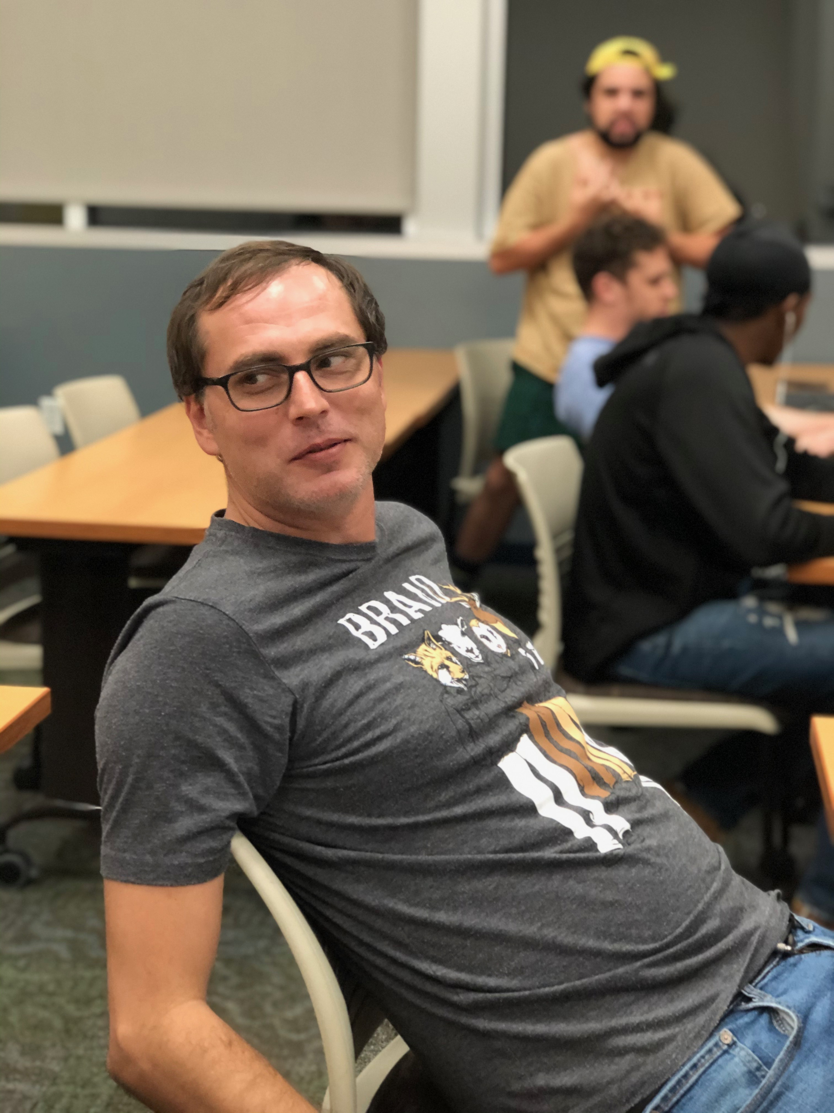
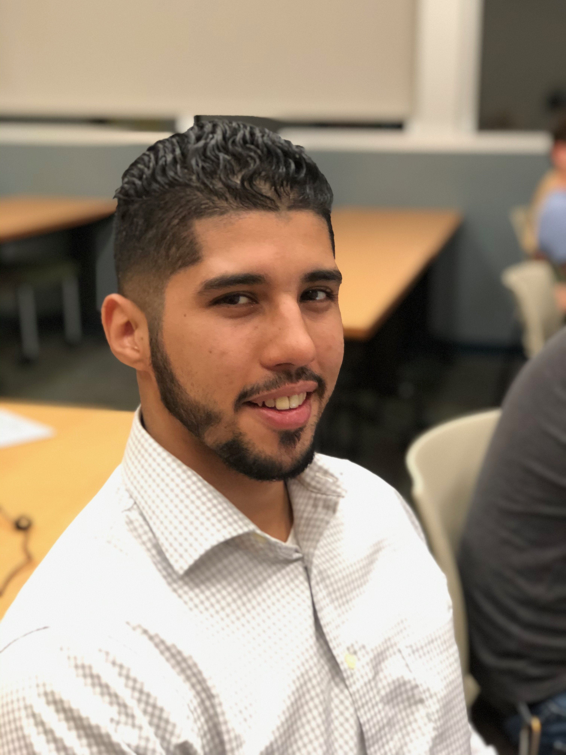
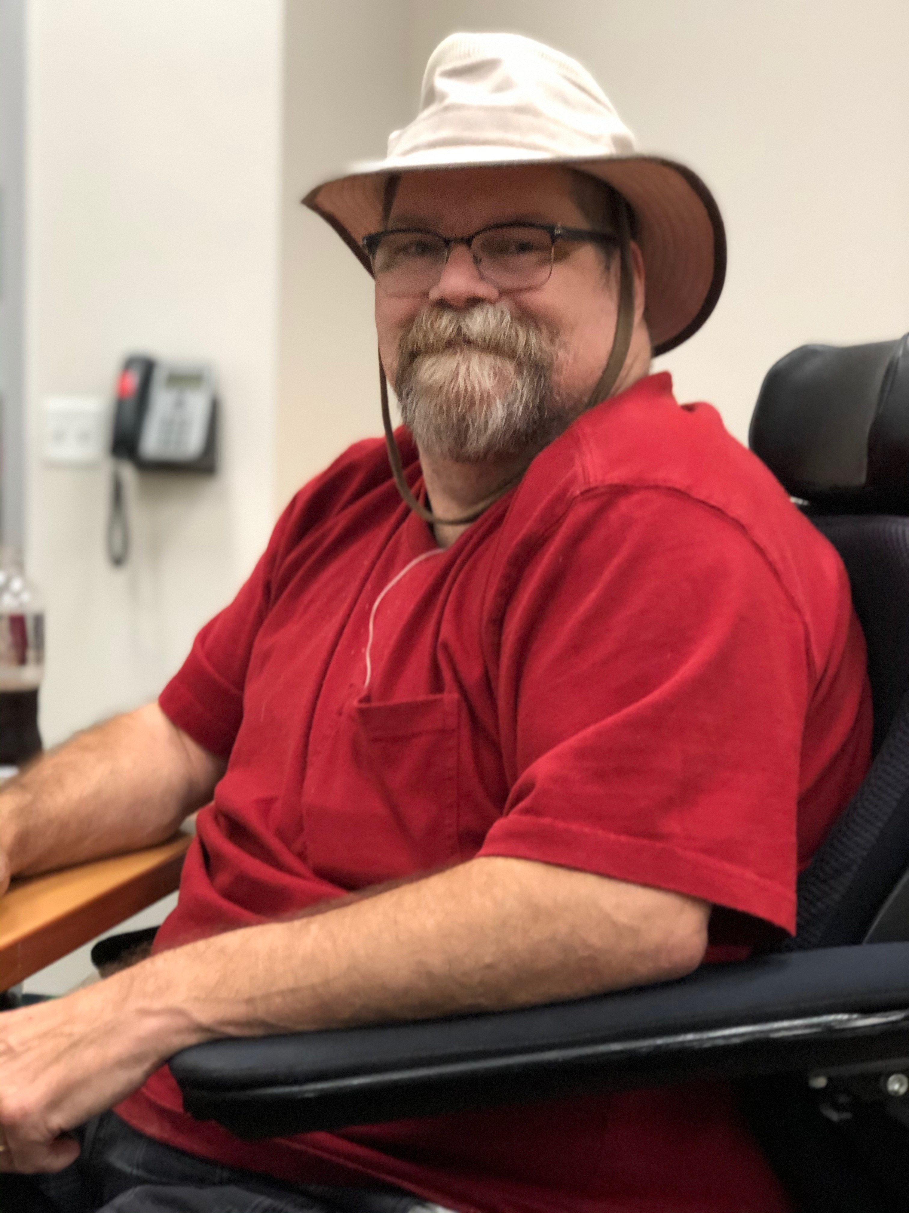
team verb 1.come together as a team to achieve a common goal:"he teamed up with the band to produce the album"synonymsjoin (up), join forces, collaborate,
Scott, “a musician, dad, and aspiring web guru”
Jed, I am the “senior” team member and fastest mover on wheels”
Anthony, “Program Manager. I work in BOM engineering at work, I like to play video games and sports on my free time. I also enjoy a good nap on my free time too.….”

Slide 3
Barber Stop concept:
A website where a user enters:
Name:,
Location:,
Phone Number:,
User Name:,
The site returns to the user:
List of shops near the user:,
(potentially: reviews, website links, coupons/discounts)
An annotated map of the area:,
The site retains data on:
User history:,
Search history:,
Site statistic:,

Slide 4
Barber Stop User Stories:
- As a Basic user I want:
- A haircut
- Convenient location
- Fair Price
- As a Intermediate user I want:
- Styled haircut
- Basic Grooming
- Fair Price
- Convenient location
All Users may want:
- Map
- Reviews print/online
- Discount/Coupons
- As a Special occasion user I want:
- Shampoo
- Shave or Beard Style
- Hot and Cold Towles
- Manicure
- Massage

Slide 5
Resources to be utilized (so far…):
HTML 5
CSS 3
Bootstrap.js
Jquery.js
Firebase.app
Firebase.database
Api keys and data returns.JSON from Yelp and Mapbox

Slide 6
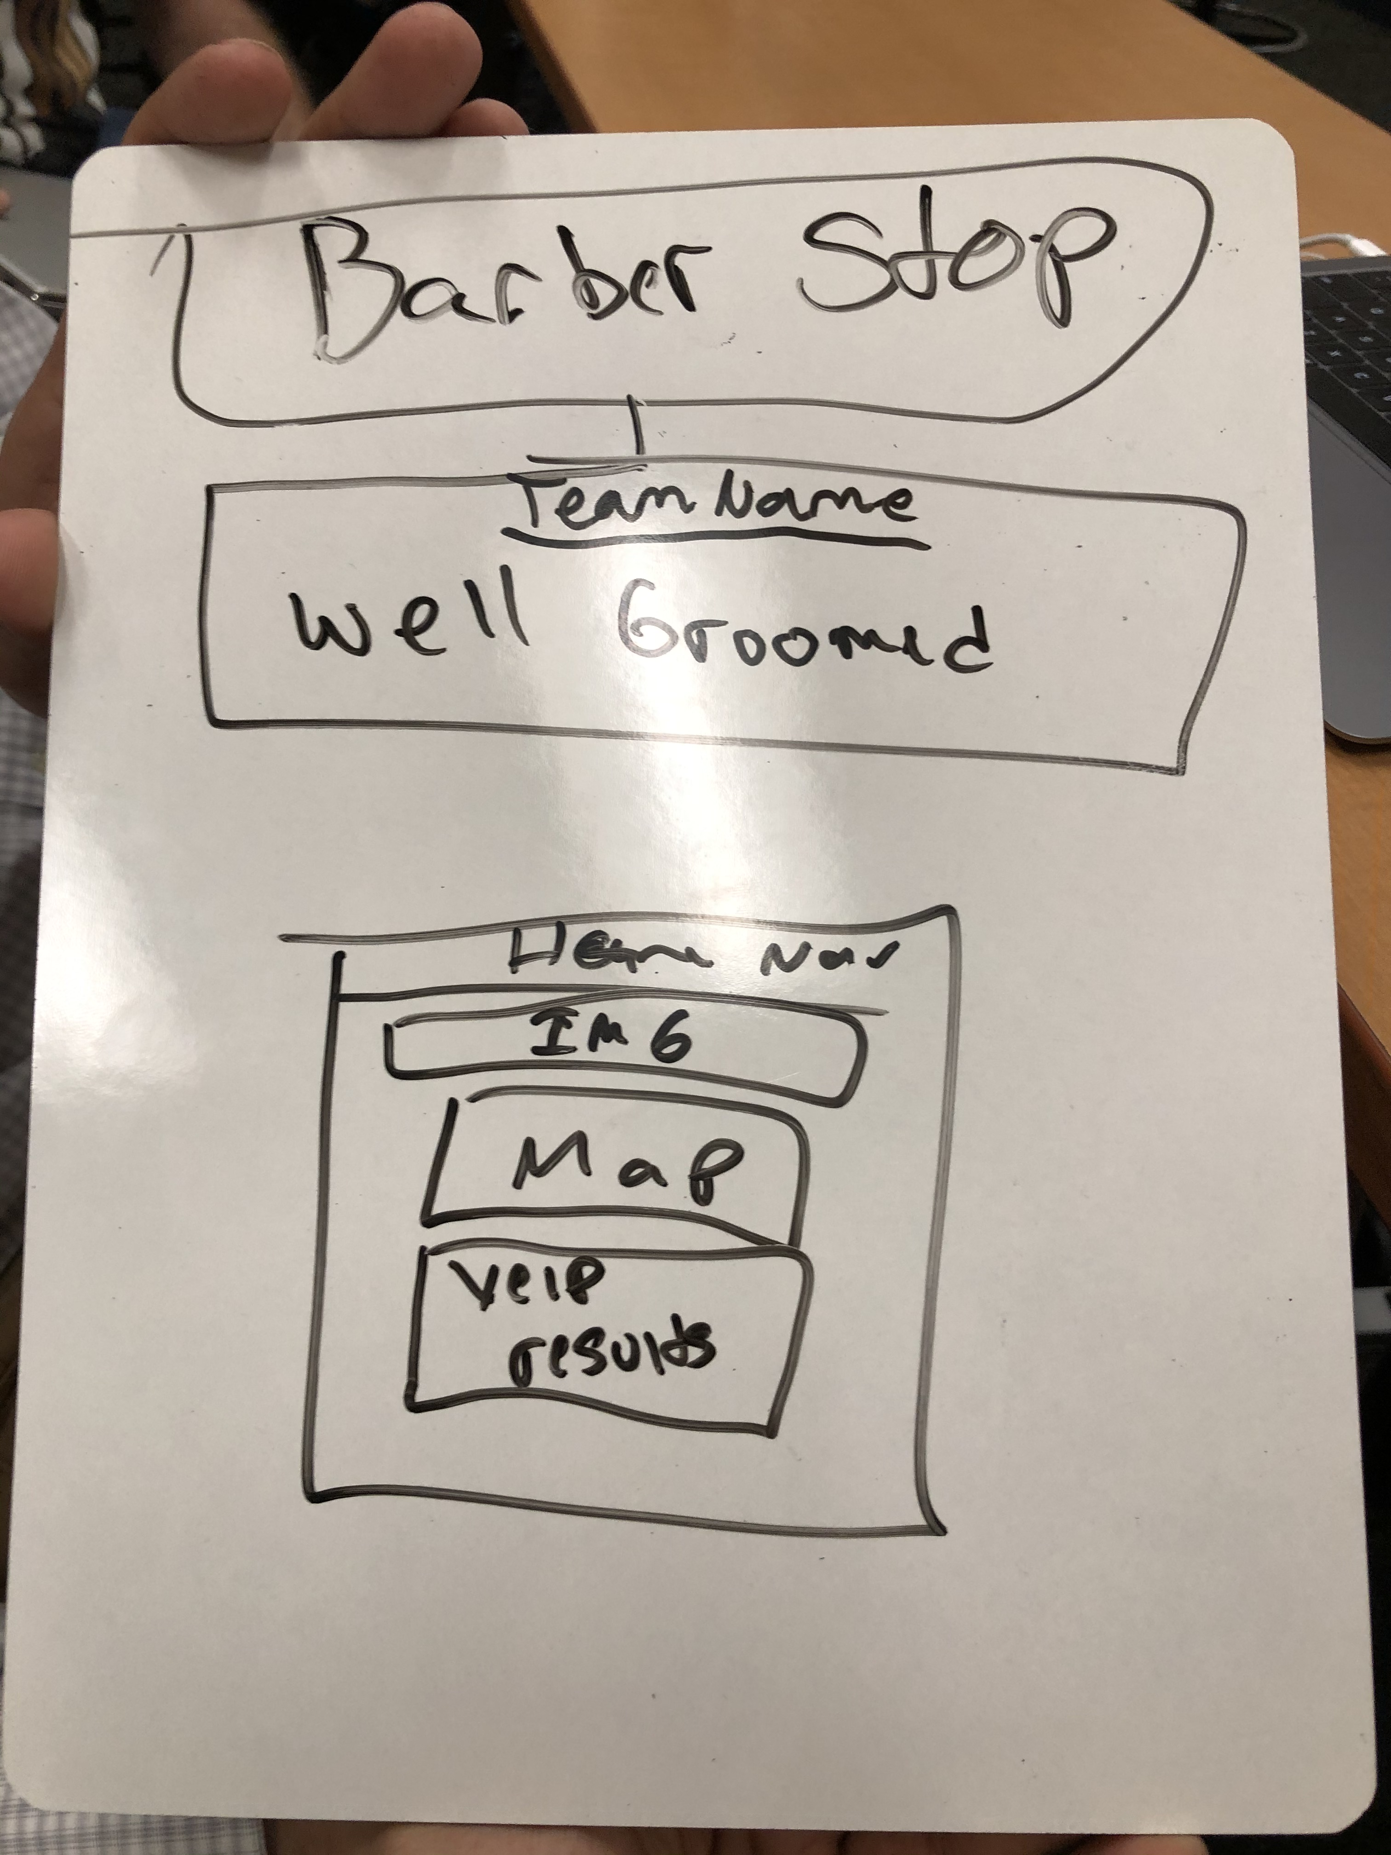
Wireframe concept:

